Slide 1
Addressing Social Isolation In Seniors: Statewide Initiative
Notes:
America’s oldest citizens are interesting and inspiring people. They are our history, our teachers, and our wisdom keepers. Each of us knows a senior who has impacted our lives for the better. However, many seniors feel isolated, alone and unimportant. As our senior population explodes in the coming years, the problem of social isolation will too.

Slide 2
Social Isolation “Triggers”
Living Alone
Geography
Low Income
Limited Transportation
Notes:
Living Alone
Geography: rural, high crime, moving away from friend/family. Neighborhood deterioration breeds mistrust and social isolation.
Low income
Limited Transportation: rural, etc

Slide 3
Risk Factors for Social Isolation
Health/disability/immobility
Sensory Impairment
Cognitive Impairment
Age
Ethnicity
LGBT
Major Life Transitions

Slide 4
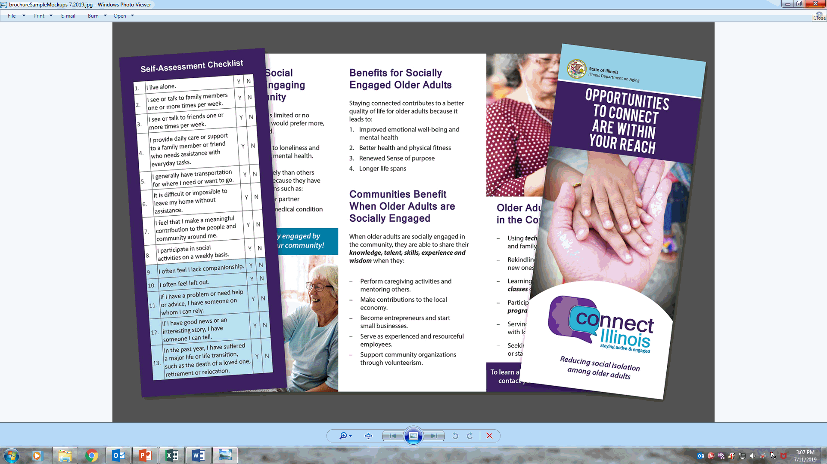

Slide 5
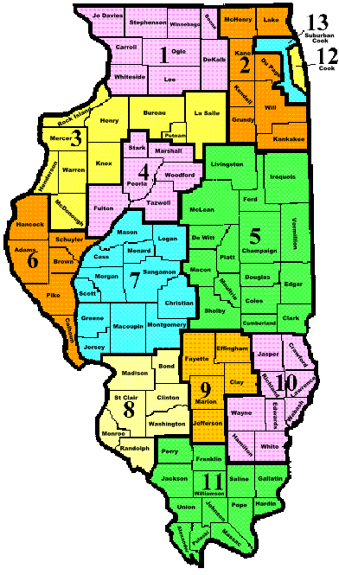
PSA 01 - Northwestern Illinois AAA – Rockford
Friendly visitor
Telephone reassurance
Remote communication and technology
Caregiver Services
Volunteer recruiting
PSA 02 - Northeastern Illinois AAA – Lombard
Breakfast collaboratives with community partners
Friendly Visitor
Telephone Reassurance
RSVP Collaborative
PSA 03 - Western Illinois AAA - Rock Island
Expand Matter of Balance program
Living and Learning Workshops
Telephone Reassurance
Collaboration with HDM providers
Activities such as Agetastic games at Congregate Meal sites
Transportation

Slide 6
PSA 04 - Central Illinois AAA – Peoria
Initiatives with HDM and Congregate Meal providers
Transportation
Friendly Visitor
Telephone Reassurance
Expand CDSM and Matter of Balance
Intergenerational Activities (Back to School picnic, Celebrating Generations, Grandparents Raising Grandchildren holiday parties)
PSA 05 - East Central Illinois AAA – Bloomington
Friendly visitor
Telephone reassurance
Remote communication and technology
Caregiver Services
Volunteer recruiting
PSA 06 - West Central Illinois AAA – Quincy
Collaboration with HDM providers
Friendly Visitor
Collaborate with RSVP
Scheduled activities

Slide 7
PSA 07 - AAA for Lincolnland, Inc. - Springfield
Aging Mastery Program
Social Isolation Task Force
RSVP Wellness Checks
Friendly visit/phone calls
Transportation
PSA 08 - AgeSmart Community Resources - O’Fallon
Experience First /Senior Skip Day (Greenville College and nutrition providers) Intergenerational Connection
Music Performance Trust Fund/MusicianFest
Telephone Reassurance
Senior Center Without Walls
Brighten the Block
PSA 09 - Midland AAA - Centralia
Friendly visitor
Telephone reassurance
Remote communication and technology
Caregiver Services
Volunteer recruiting
PSA 10 - Southeastern Illinois AAA, Inc. - Mt. Carmel
Collaboration with HDM providers
Friendly Visitor
Collaborate with RSVP
Scheduled activities

Slide 8
PSA 11 - Egyptian AAA, Inc. - Carterville
Telephone Reassurance
Friendly Visitor
Healthy Ideas (anti-depression counseling)
Social Media (FB, Twitter and Instagram)
Take Care of Your Health
Utilize RSVP
PSA 12 - Senior Services AAA - Chicago Dept. of
Family & Support Services
Chicago Fitness Plus
Collaboration with HDM providers
Senior Centers
Caregiver Support
Crisis Intervention
Remote Communication/Technology
PSA 13 - AgeOptions, Inc. - Oak Park
Telephone Reassurance
Friendly Visitor
Healthy Ideas (anti-depression counseling)
Social Media (FB, Twitter and Instagram)
Take Care of Your Health
Utilize RSVP

Slide 9
Alzheimer’s Disease and Related Dementia Initiative

Slide 10
Illinois Alzheimer’s Disease Statistics
220,000 people aged 65 and older are living with Alzheimer’s in Illinois.
590,000 family caregivers bear the burden of the disease in Illinois.
More than 60% of these unpaid caregivers have been providing care 2 years or more.
More than 1/3 of Illinois caregivers provide care for 20+ hours per week.
Almost 25% of these caregivers are in the “sandwich” generation.
672 million hours of unpaid care provided by Alzheimer’s caregivers.
$8.5 billion is the value of the unpaid care.
alz.org/media/Documents/illinois-brfss-caregiving-2016

Slide 11
As compared to other caregivers, Caregivers of Persons with Dementia are:
Twice as likely to have physical or psychological problems.
More than twice as likely to use medications for mood or nerves.
At much higher risk of social isolation.
Only half as likely to use health care.
The Savvy Caregiver Trainer’s Manual, p. 33

Slide 12
Services Funded under the ADRD Initiative
Evidence-Based Educational Programs for Caregivers
Savvy Caregiver
Stress Busting for Caregivers
Supportive Gap Filling Services

Slide 13
Savvy Caregiver Objectives
Increase Caregiver’s Skill and Knowledge for Caregiving.
Reduce the Potential Adverse Impacts of Caregiving.
Help Caregiver’s Develop More Effective Strategies for Caregiving and Decision-Making.
Improve Caregiver’s Self-Care Skills.
Increase Involvement of Families and Other Resources.
The Savvy Caregiver Trainer’s Manual, p. 23

Slide 14
Stress Busting for Caregivers Objectives
To improve the quality of life of family caregivers who provide care for people Alzheimer’s disease and other dementias.
Help caregivers manage their stress and cope better with their lives.
Stress Busting for Caregivers Facilitator’s Manual, p. 4

Slide 15
Supportive Gap Filling Services for Persons with Dementia and Their Caregiver
Home Modifications/Repairs
($2,000 per year)
Medical Care/Supplies
($1,500 per year)
Environmental and Material Aids
($1,500 per year)
Community Access
($1,500 per year)

